Slide 1

GESTURE BOT
Practical utilization of gesture recognition in motion-controlled robotics
Group 3:
Bjørn Sødal · Cornelius Brandt · Fynn Schilke ·
Maximilian Eckstein · Harshal Ghadge

Slide 2

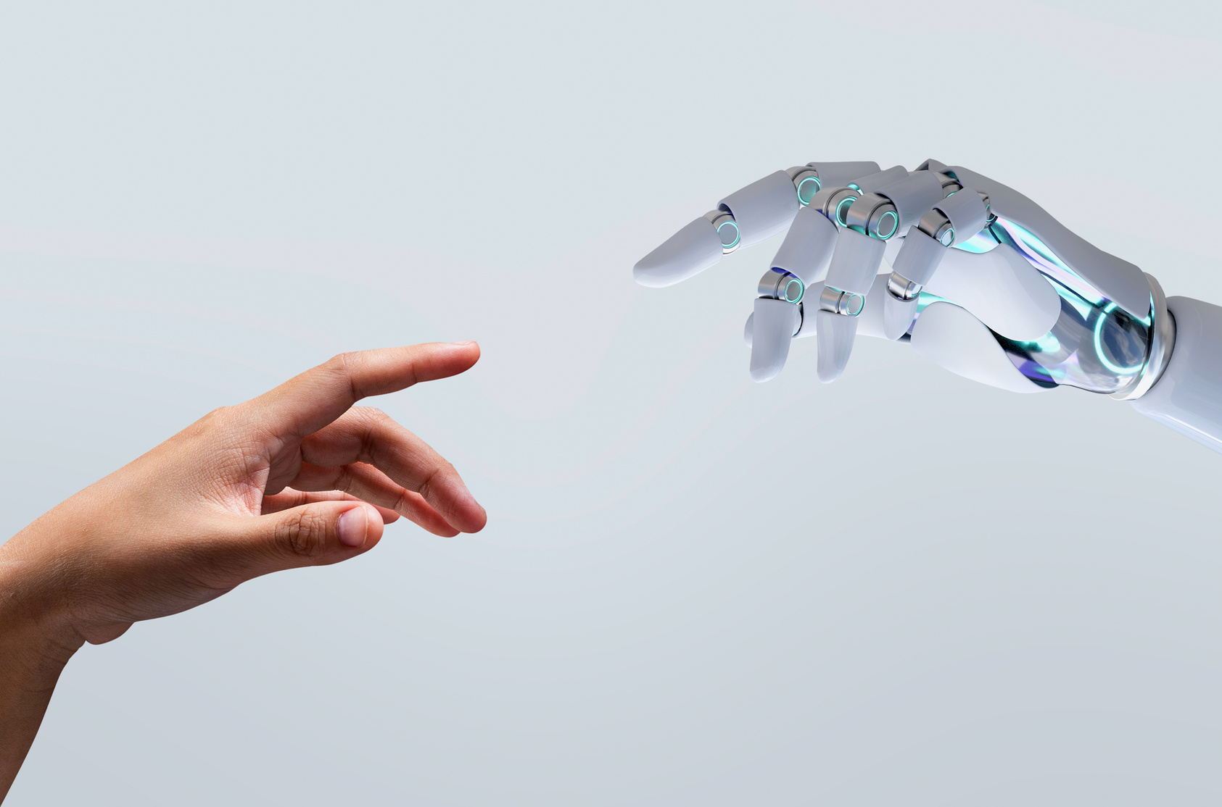

PROJECT IDEA
Gesture-controlled mobile robot
Enables more intuitive human–robot interaction
Uses two-hand control: one for navigation, one for arm movement
Provides live camera feedback for the operator

Slide 3
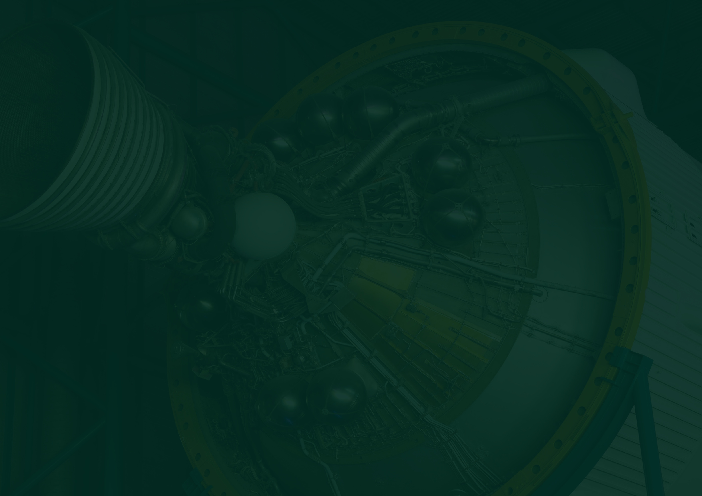




CHALLENGES
Gesture recognition accuracy
3D positions
Reliable gesture recognition under varying lighting conditions and hand orientations
3D hand tracking without depth sensors
System Integration
Complicated Setup
Seamless communication between PC and robot (e.g. signal transmission problems)
Complex setup and compatibility issues across multiple PCs
02

Slide 4



SOLUTIONS
MediaPipe 3D mapping
MediaPipe
MediaPipe provides simple 3D detection
Estimating missing position data using 3D landmark projection (approximation, not full depth)
Different approaches for arm movement (e.g. LiDAR-based or visual estimation) are currently being evaluated
21 hand landmarks detected via MediaPipe
Fast and accurate real-time recognition pipeline
Hand-Landmark-Pipeline with pretrained model
ROS 2 Humble
Docker
controlling robot velocities
manages communication between RaspberryPi and PC
Docker container for consistent, plug-and-play system setup
03

Slide 5


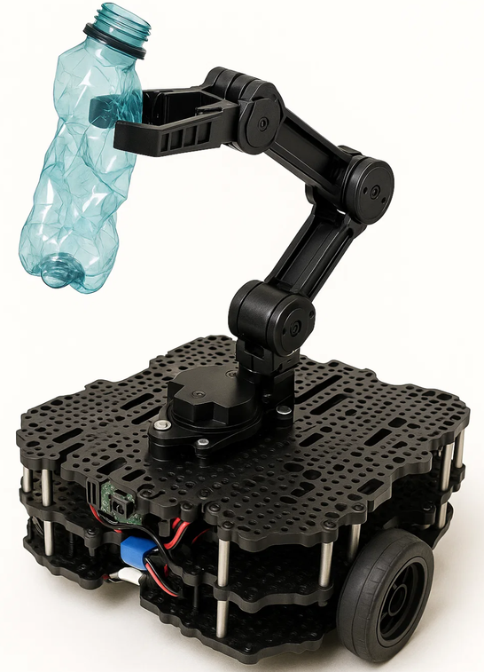
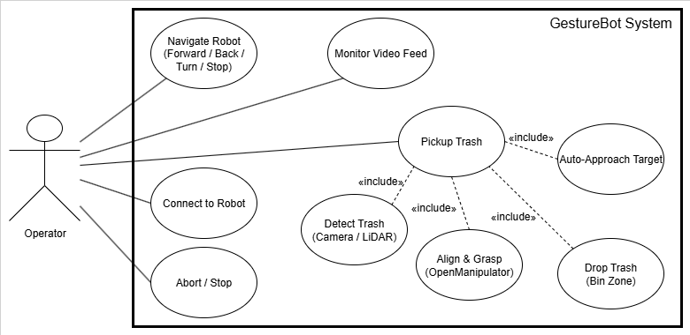
FUNCTIONAL REQUIREMENTS
USE-CASE SECNARIO
Gesture-based movement control
Gesture-based arm activation and positioning
Real-time video feedback
“Trash Pickup” – robot identifies and picks up a nearby object
04

Slide 6


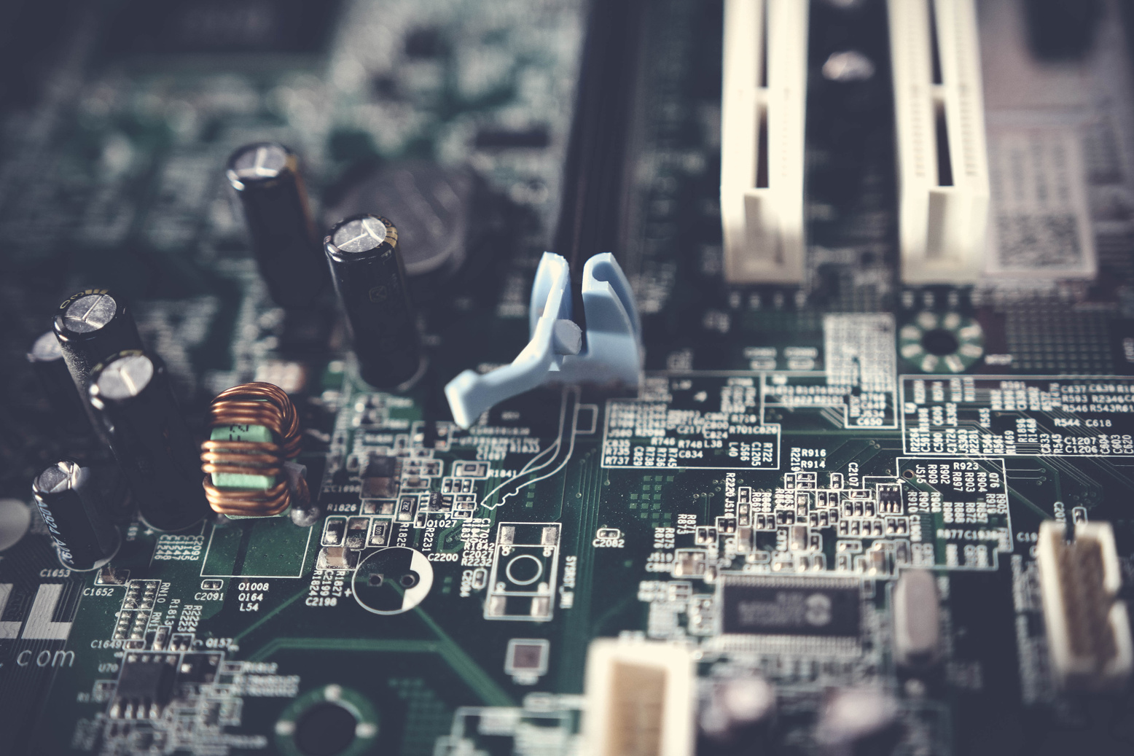
DATASET & SYSTEM HARDWARE SETUP
SYSTEM
TurtleBot3 Waffle Pi with Raspberry Pi 4
ROS 2 Humble running on both PC and Pi (via Docker)
Wi-Fi connection between PC and robot
All computation handled on PC; Pi receives movement commands
ROS Publisher–Subscriber architecture for modular design
DATASET
Based on a non-public MediaPipe dataset (Google)
Pretrained neural network model for hand landmark detection
05

Slide 7
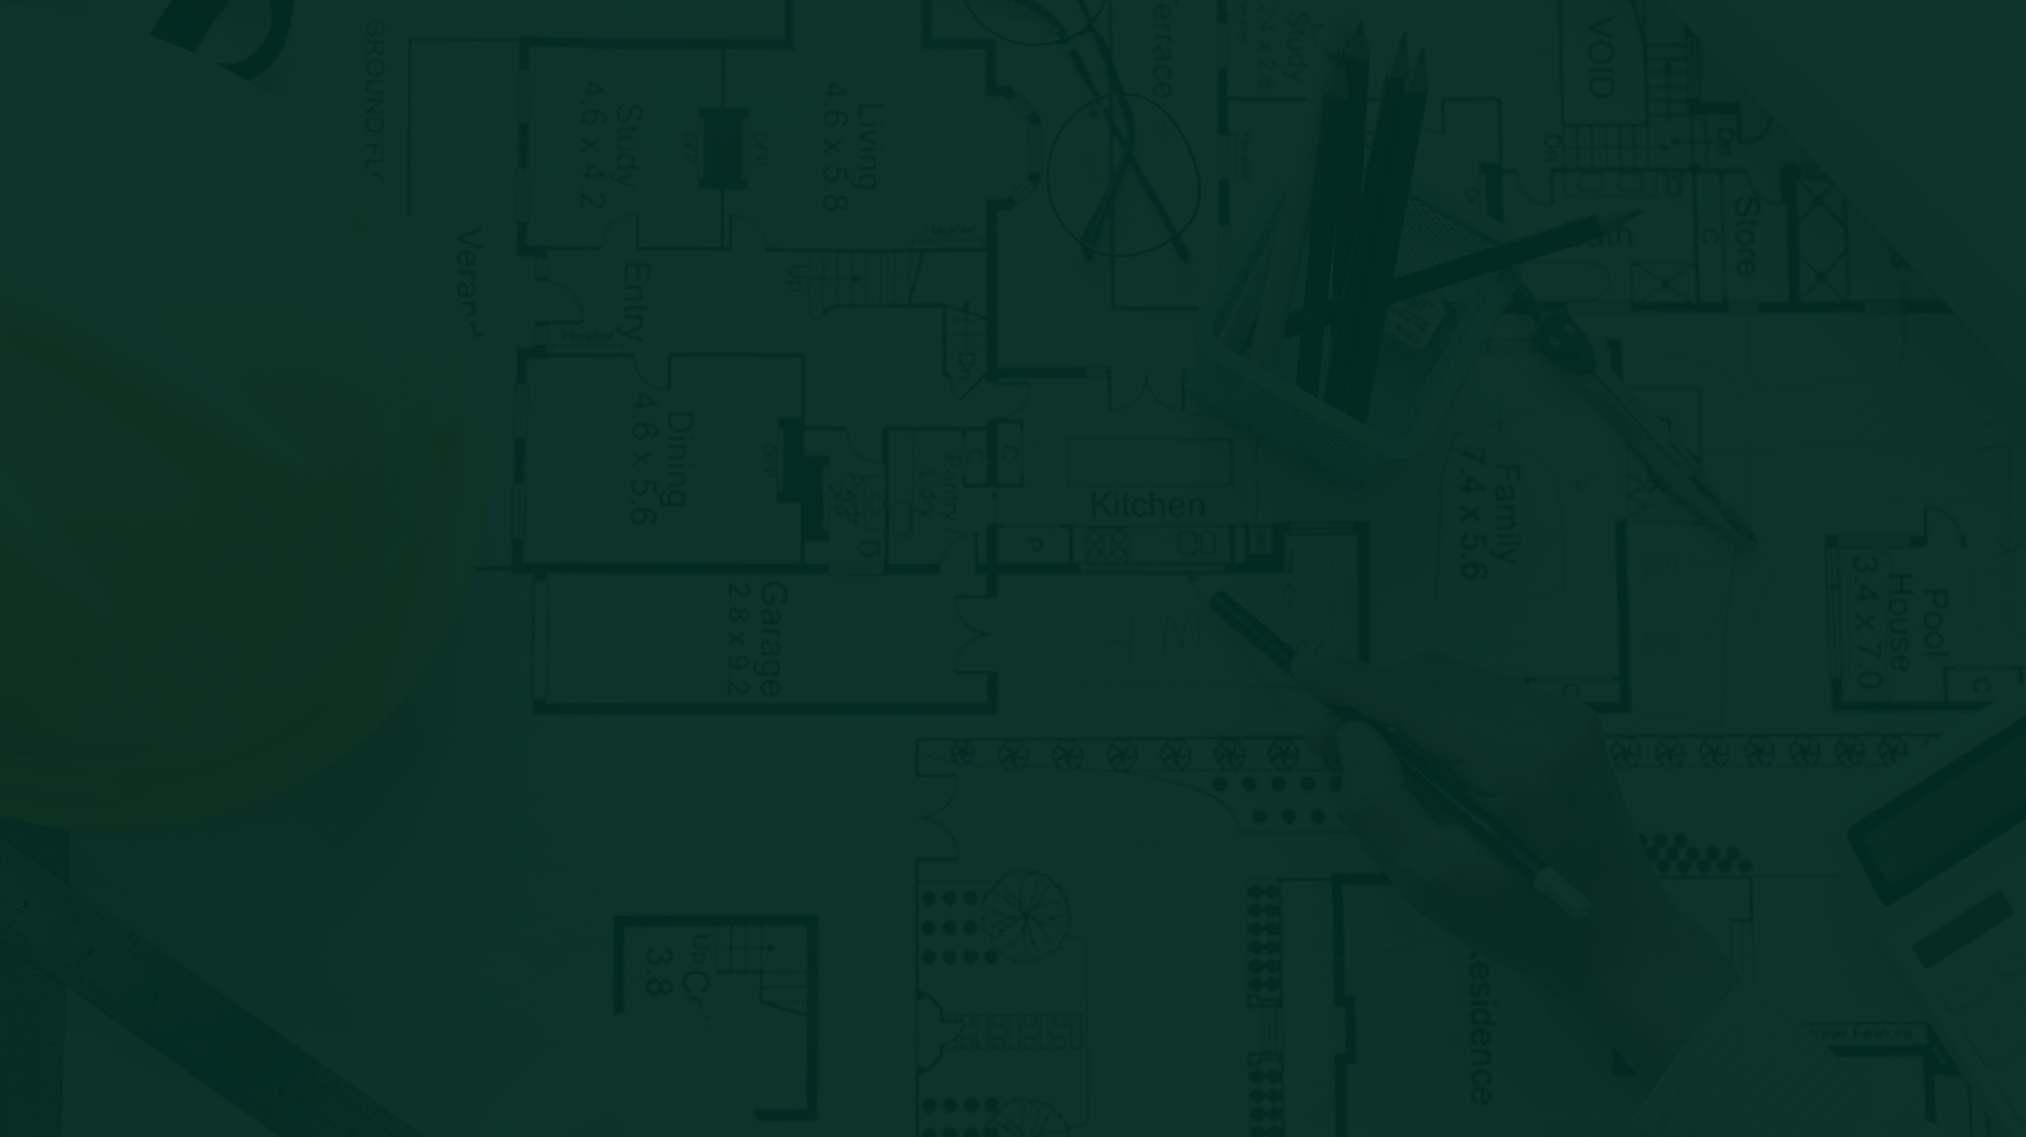
NEXT STEPS
PLANNING
OBSTACLES
No major changes in project timeline
Integrate and test robotic arm control functionality
Continue testing and troubleshooting of the ROS setup
Finalize Docker container for easy deployment
project report and preparing demonstration
Occasional communication issues in university network
Video output stability issues
Outdated camera package dependencies
06

Slide 8
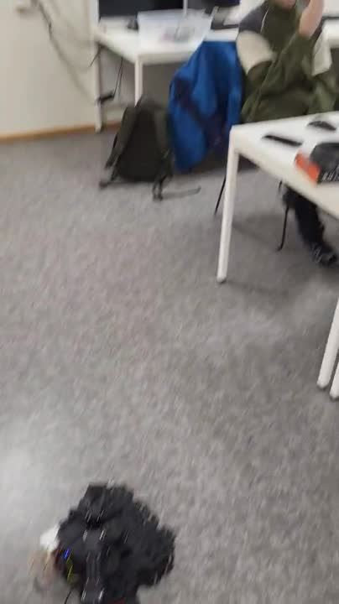

Slide 9
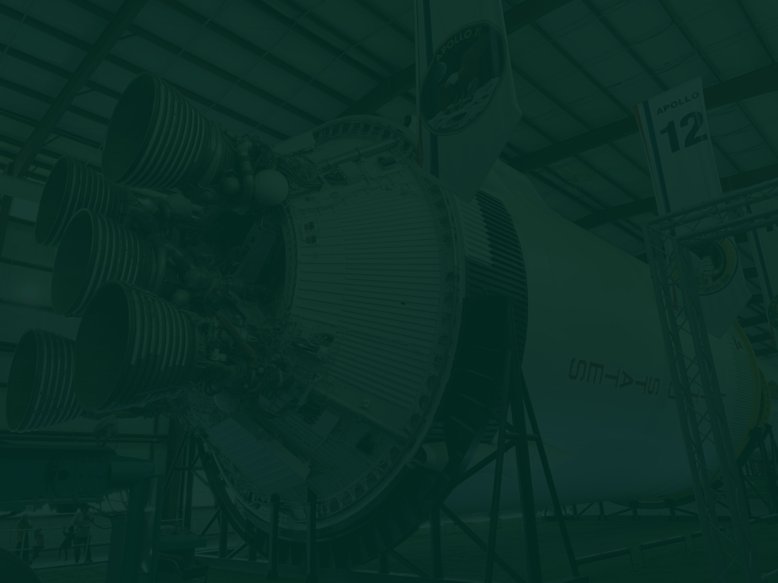
THANK YOU
Questions & feedback are welcome!

